Slide 1
FEM2401 Malaysian Politics and Society TOPIC 4: CONSTITUTIONAL MONARCHY
Lecturer:
MUHAMMAD AMIR BIN MUNSHI

Slide 2
TOPIC 4: CONSTITUTIONAL MONARCHY
LEARNING OUTCOME :
● To explain the concept constitutional monarchy
● To understand the structure and role of the institution of constitutional monarchy
Overview :
- Background of the monarchy system
- The concept of constitutional monarchy
- Yang di-Pertuan Agong (The King)
- Conference of rulers

Slide 3
Terms
Yang di-Pertuan Agong (YDPA) = The King = The Head of Country/State/Federation
Sultan = Raja = Malay Ruler/Ruler = Head of nine states [Perlis, Kedah, Perak, Selangor, Negeri Sembilan (Yamtuan), Johor, Pahang, Terengganu, Kelantan]
Timbalan Yang di-Pertuan Agong = Deputy of the Yang di-Pertuan Agong
Yang di-Pertua Negeri = State Governor = Head of four states (Pulau Pinang, Melaka, Sabah and Sarawak)
Raja Permaisuri Agong = The Queen (wife to the King)
Majlis Raja-raja = Conference of Rulers / Council of Rulers

Slide 4
BACKGROUND OF THE MONARCHY SYSTEM
FROM ABSOLUTE POWER → LIMITED BY CONSTITUTION
Malacca Sultanate/Empire
Sultan was the head of the state - control every aspect of the state administration (absolute) such as economy, politics and social
The Malay and Islam were given the highest position
Portuguese and Dutch’s Colonial
The structure of the state administration not much different during Portuguese and Dutch colonialization – Sultan was the highest position
British colonial
Indirect rule of the British changed of powers of the Sultan/Malay rulers (Residential system, Malayan Union, Federated Malay States)
Sultan’s powers reduced in matters of Islamic matters and Malay custom
Conference of Rulers was established in 1897

Slide 5
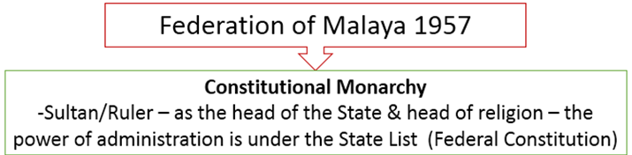

Slide 6
CONCEPT OF CONSTITUTIONAL MONARCHY
A constitutional monarch is a hereditary symbolic head of state (who may be an emperor, king or queen, prince or grand duke) who mainly performs representative and civic roles but does not exercise (the actual) executive or policymaking power.
Constitutional monarchies are found in some countries such as in UK, Belgium, the Netherlands, Sweden, Thailand, Japan and Malaysia.
The role of constitutional monarchs in parliamentary democracies
the effective powers of government are hold by a Prime Minister and cabinet who are politically responsible to the parliamentary majority;
there is a hereditary monarch who is restricted to representative, ceremonial and civic duties, and sometimes to the role of a constitutional arbiter.

Slide 7
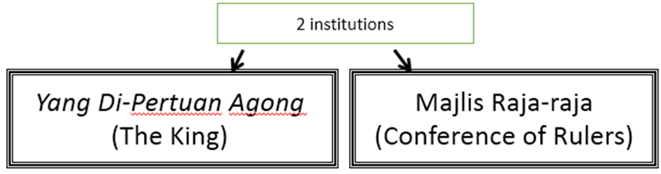
Monarchy system according to rules/ constitutional provisions
Indirect powers– represented by the People’s Representatives
Yang Di-Pertuan Agong (YDPA) – head of the country: YDPA has symbolic duties
Acts in accordance to advice given

Slide 8
APPOINTMENT OF YDPA
Based on Table 3 of The Federal Constitution
Only rulers are chosen based on their seniority (according to the duration they are rulers in their respective states)
Vote is only done by the rulers- in attendance are the rulers and Penyimpan Mohor Besar Raja-raja or PMBRR (the Keeper of the Rules’ Seal)
The Keeper of the Rules’ Seal will conduct the voting process
Appointment in rotation- cannot be chosen twice in one turn (appointment is every 5 years)
Results of the votes are private and confidential
Minimum 5 votes from the Conference of Rulers
Appointment can be hastened if:
YDPA passes away
A ruler that is eligible and has been appointed turns down the position
Conference of Rulers finds the candidate not suitable

Slide 9
Two main principles about the power of YDPA
YDPA must act based on principle of ‘acting on advice’
YDPA has discretionary power
Discretionary power (a power granted to a head of state or government to act on his own discretion under certain conditions).
MAIN ROLES OF YDPA
Head of the country/Head of the federation
Head of the executive body
Head of the legislative body
Head of judiciary body
Head of armed forces
Head of religion/Islam

Slide 10
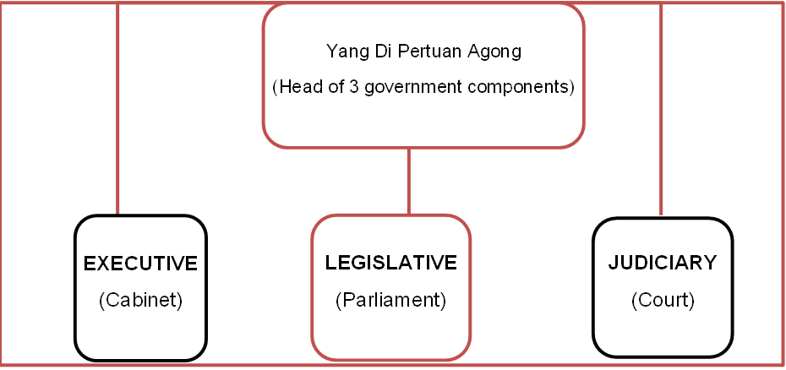

Slide 11
What is the rationale of the YDPA being the head of the three government components?
Pillar to ensure the objectivity and neutrality as well as transparency of the nation’s administration.
Principle of ‘acting on advice’- doesn’t have absolute power BUT has the right to receive ALL information on administrative matters
RESPONSIBILITIES OF YDPA
Legislative duty
Legislative power in Parliament, approval of the bills
Executive function:
Appointment of the highest position in the administration
Discretionary power
Judiciary function
Pardoning power
Protect the welfare/Safety of rakyat (People/Citizen)
Safeguarding the special positon of the Malays and natives of Sabah and Sarawak; other ethnic as well
Head of Islam
Islamic affair administration in the states and Federal territories

Slide 12
YDPA AS HEAD OF THE COUNTRY (Executive Power)
Article 40(1) – Acts on the advice of the Cabinet or any ministers acting on the powers given by Cabinet.
Has the right to receive all information about administrative matters from the Cabinet
Appointment of highest position in the country
Prime Minister and Cabinet ministers
Head of Judiciary (Chief Justice), judges, Auditor General, members of the Public Service Commission and Election Commission etc.
Article 40(2):- Discretionary power
the appointment of a prime Minister
the withholding of consent to a request for the dissolution of parliament (to refuse a request for the dissolution)
the requisition of a meeting of the Conference of Rulers concerned solely with the privileges, position, honours and dignities of their Royal highnesses, and any action at such a meeting (can request for a session meeting)
other roles and responsibilities mentioned in the Constitution

Slide 13
Power to appoint or to require the resignation of the members of Cabinet or the deputy (on advice of PM)
Power to appoint positions such as
Members of ; Election Commission and Public Service Commission
Auditor General
Attorney General
Members of Legislative Assembly
Yang Di Pertua Negeri (Governor of State)
Appoint ambassador and high commissioner of Malaysia to other countries

Slide 14
YDPA AS HEAD OF THE COUNTRY (Legislative Powers)
Article 44 - YDPA the House of Representatives and Senate. YDPA must consent to the legal bill before it can be promulgated as a legal law.
Article 55 – YDPA has the power to call, stop and dissolve the Parliament.
Agrees/disagrees to legal bills that require the consent of the Conference of Rulers
YDPA AS HEAD OF THE COUNTRY (Judiciary Powers)
Article 122 – appoint the head of judiciary (Chief Justice), judges of Federal Court and high court.
Must act on the advice of Chief Justice.
Article 42 – power to grants pardon
YDPA AS HEAD OF THE COUNTRY (Head of Islam)
For 4 states & 3 Federal Territories
Considers things in relation to Islam, as well as cultural and traditional matters
Pass the state bills related to Islamic affairs and laws (state enactment)

Slide 15
YDPA AS HEAD OF THE COUNTRY (Other responsibilities)
STATE ADMINISTRATION
Considers state lines and demarcation
Power to declare a state of Emergency and introduce emergency laws (Article 150)
Expands members of the Federation
YDPA AS HEAD OF THE COUNTRY (Protect the society, country sovereignty and culture)
Safeguarding the special position of the Malays and natives of Sabah and Sarawak
Ensures and protects the Malay culture and tradition
Ensure and protect the interests of other races
Safeguard the privileges, position, honours and dignities of the Malay Rulers / Their Royal Highnesses

Slide 16
THINGS THAT CANNOT BE DONE BY THE YDPA
He cannot perform functions in his own state except as:
Head of religion/Islam
Role and power related to constitutional amendments
Power to appoint a Pemangku Raja (Regent) and members of Majlis Pangkuan Raja (Regent Council) in his state
Cannot hold position with remuneration
Cannot partake in business
Cannot accept any salary from his state (as ruler in his own state)
Cannot leave Malaysia in the span of 15 days; except with leave from the Conference of Rulers or on official tours
* The Queen also cannot hold any position in the Federal or State Government

Slide 17
TIMBALAN YDPA (DEPUTY OF YDPA)
To execute the responsibilities of the YDPA in his absence
Enjoy all the privileges of the YDPA
Appointed by the Conference of Rulers for 5 years
Can tender written resignation to the Conference of Rulers
Not automatically appointed after the YDPA serves his term

Slide 18
LIST OF SENIORITY OF SERI PADUKA BAGINDA YANG DI-PERTUAN AGONG
1. YANG DIPERTUAN BESAR NEGERI SEMBILAN DARUL KHUSUS
2. SULTAN OF SELANGOR
3. RAJA OF PERLIS
4. SULTAN OF TERENGGANU
5. SULTAN OF KEDAH
6. SULTAN OF KELANTAN
7. SULTAN OF PAHANG (Current YDPA)
8. SULTAN OF JOHOR
9. SULTAN OF PERAK DARUL RIDZUAN
More info about the list of previous His Majesty King:
https://www.parlimen.gov.my/yda-senarai-yang-di-pertuan-agong.html?uweb=yg&lang=en

Slide 19
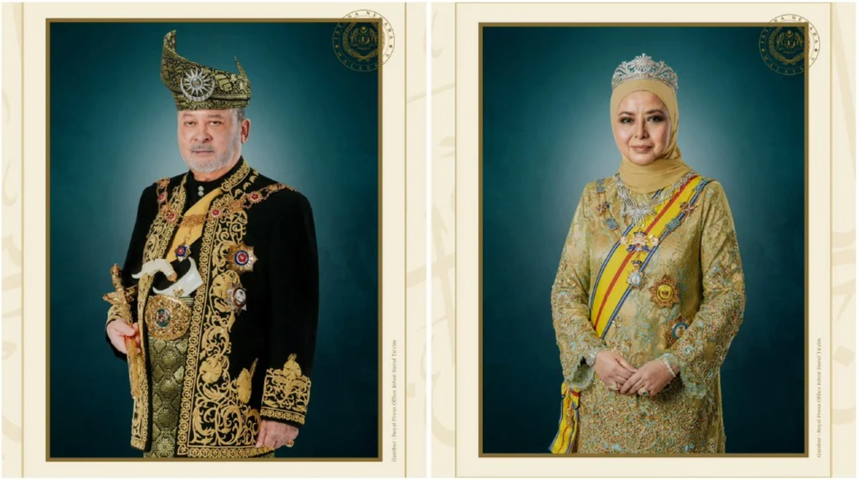
Current YDPA and Raja Permaisuri Agong (The Queen)
Yang di-Pertuan Agong His Majesty Yang Maha Mulia Seri Paduka Baginda Yang di-Pertuan Agong XVII Sultan Ibrahim Ibni Almarhum Sultan Iskandar and the Raja Permaisuri Agong Raja Zarith Sofiah binti Almarhum Sultan Idris Shah.
From Johore (Sultan or Ruler of Johor)

Slide 20
CONFERENCE OF RULERS
A council comprising nine rulers of Malay states and four governor(head of state) of Sabah, Sarawak, Penang and Malacca.
Established officially in 1948 after the Federation of Malaya was established.
Has close relationship with federal government and governments at the state level
Subject to constitutional provisions
Approval in certain legal amendments, consultations, negotiations and appointments as well as pardoning powers
Has a DISCRETIONARY POWERS

Slide 21
Article 38 (2): Role of Conference of Rulers
Electing, in accordance with the provisions of the Third Schedule, the Yang di-Pertuan Agong and Timbalan Yang di-Pertuan Agong;
Agreeing or disagreeing to the extension of any religious acts, observances or ceremonies to the Federation as a whole;
Consenting or withholding consent to any law and making or giving advice on any appointment which under this Constitution requires the consent of the Conference or is to be made by or after consultation with the Conference;
Appointing members of the Special Court under Clause (1) of Article 182; or
The granting of pardons, reprieves and respites, or of remitting, suspending or commuting sentences, under Clause (12) of Article 42 and may deliberate on questions of national policy (for example changes in immigration policy) and any other matter that it thinks fit.

Slide 22
DISCRETIONARY POWERS OF THE CONFERENCE OF RULERS [Article 38(6)]
the election or removal from office of the Yang di-Pertuan Agong or the election of the Timbalan Yang di-Pertuan Agong;
the advising on any appointment;
the giving or withholding of consent to any law altering the boundaries of a State or affecting the privileges, position, honours or dignities of the Rulers;
the agreeing or disagreeing to the extension of any religious acts, observances or ceremonies to the Federation as a whole;
the appointment of members of the Special Court under Clause (1) of Article 182; or
the granting of pardons, reprieves and respites, or of remitting, suspending or commuting sentences, under Clause (12) of Article 42.

Slide 23
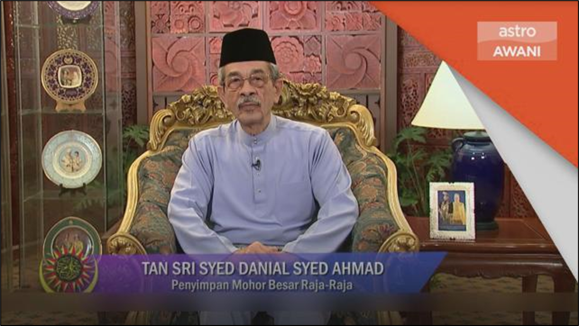
"The Keeper of the Rulers' Seal”
Secretary to the Conference of Rulers
Convene the Conference of Rulers whenever required to do so by the Yang di-Pertuan Agong or by not less than three members of the Conference
Conduct the process of the election of the Yang di-Pertuan Agong
Spokesperson for the Conference of the Rulers – announcing the date of the beginning of Ramadan, Eid-fitr and Eid-Adha etc

Slide 24
MEETING OF THE CONFERENCE OF RULERS
3 or 4 times a year for three days.
2/13 members present for meeting
The most senior ruler will be the chairman of the conference.
Meeting of Conference of Rulers accompanied by the YDPA and PM- rulers and CM- YDPN and Chief Minister except in the appointment of the YDPA and his deputy.
Keeper of the Rulers’ Seal (Penyimpan Mohor Besar Raja-raja) as a secretary to the Council.
Special meeting may be held if need arises- particularly when it relates to interests and position of rulers- usually chaired by the YDPA.
Meeting with the people’s representatives- discuss about the country and related interests openly but closed to the public.
YDPN (Head of the state such as Penang, Malacca, Sabah and Sarawak) is not involved in the appointment of the YDPA

Slide 25
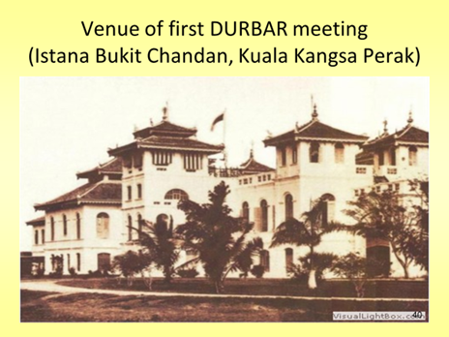
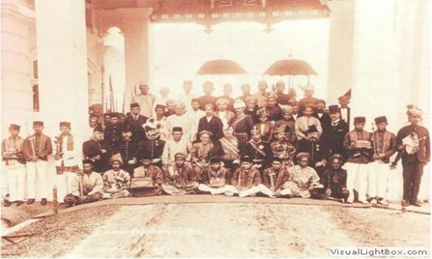
First Meeting of Conference of Rulers Federated Malay States (DURBAR) 1897

Slide 26
THE AMENDMENTS THAT REQUIRE THE CONSENT OF CONFERENCE OF RULERS
• State boundary (Article 2)
• Special position of the Malay and the Native (Article 153)
• Sovereignty of the Malay language (Article 152)
• Sovereignty of the Malay Rulers (Article 181)
• Traditional/Indigenous elements in the constitutions

Slide 27
IMMUNITY OF RULERS
Since independence The King (YDPA) and the State Rulers had legal immunity – The Constitution provided that the Rulers cannot be prosecuted by Criminal Court unless he/they voluntarily wishes to surrender the immunity.
1993 – Amendment on the immunity of rulers.
After the amendment of Article 181, the King (YDPA) and the state Rulers can be prosecuted for any criminal or civil wrongs/transgressions outside of his official capacity.
Any proceeding shall be brought in a Special Court
Article 181(2):“There shall be a court which shall be known as the Special Court and shall consist of the Chief Justice of the Federal Court, who shall be the Chairman, the Chief Judges of the High Courts, and two other persons who hold or have held office as judge of the Federal Court or a High Court appointed by the Conference of Rulers”.
Article 181(2) “Any proceedings by or against the Yang di-Pertuan Agong or the Ruler of a State in his personal capacity shall be brought in a Special Court established under Clause (1)”.

Slide 28
CONCLUSION
Monarchy system is an inherited political system that demonstrates national/traditional identity
Constitutional Monarchy
Has structure and procedures that has been set by the Constitution
Pillar of the Country
Foundation of balance of rights as well as the people’s interests
The structure of monarchy system in Malaysia probably similar to monarchy in UK but the functions and roles are different because the power of the YDPA is recognized in the written constitution.

